Slide 1
(Implicit) Hate Speech Detection
The Neural Networkers
Eesha Shekhar, Zongxin Cui, Yash Nakadi
Lavnik Balyan, Zongxin Cui, Yash Nakadi, Eesha Shekhar

Slide 2
Motivation
The goal of our project is to build better methods for the automatic identification of hate speech, including potentially identifying specific kinds of implicit hate speech.
Hate speech identification is a difficult problem in large part because language varies greatly by platform and by target, and because distinguishing between hate speech and other speech (such as sarcasm or comedy) containing sensitive words requires a complex understanding of language.
In addition, a complex understanding of language is required for when "adversarial" hate speech is written to avoid being flagged and moderated.
By analyzing the performance of our models across hate-speech categories and fine-tuning it accordingly, we will look to ensure that our model is robust to target variation in its predictions.

Slide 3
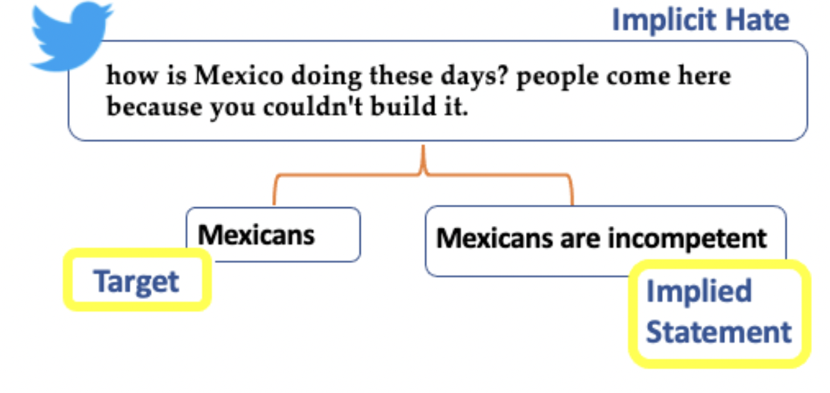
Dataset Description
We chose to use the Implicit Hate Dataset, containing 22k tweets broken into three major categories (explicit hate, implicit hate, not hate), with 6,346 implicit hate examples.
The implicit hate examples are further broken down into six minor classes:
Incitement (20%)
Inferiority (13.6%)
Irony (12.6%)
Stereotypical (17.9%)
Threatening (10.5%)
White grievance (24.2%)

Slide 4
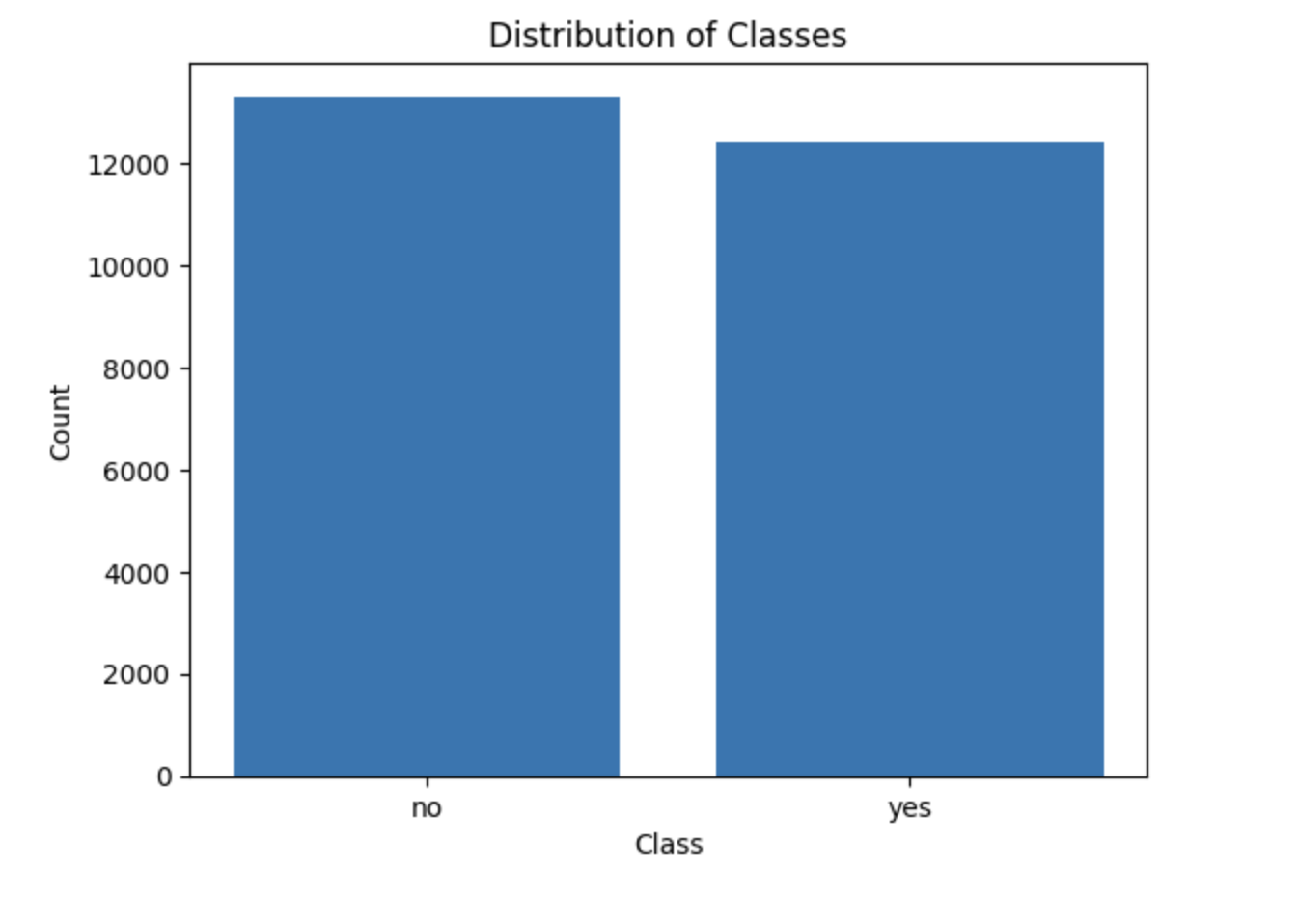
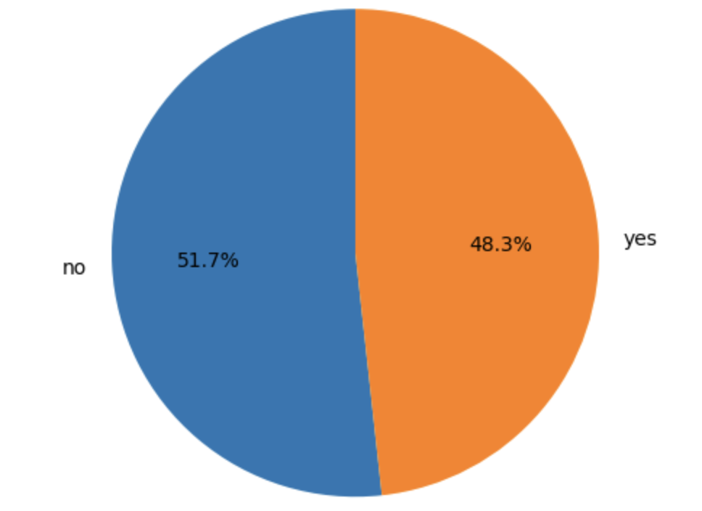
Dataset Analysis for Binary Hate Speech Classification
no 13294
yes 12401

Slide 5
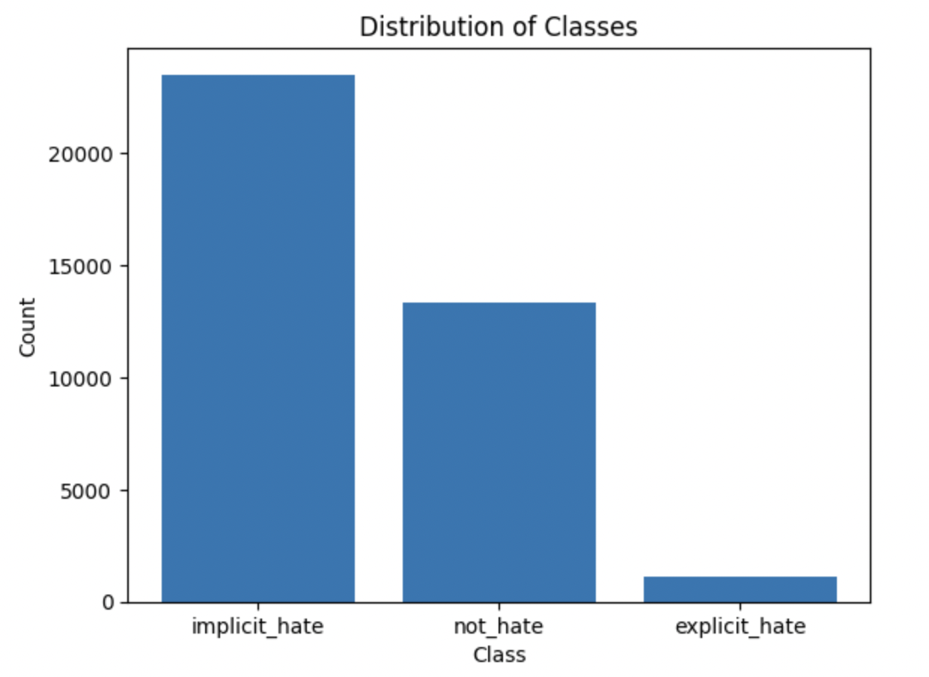
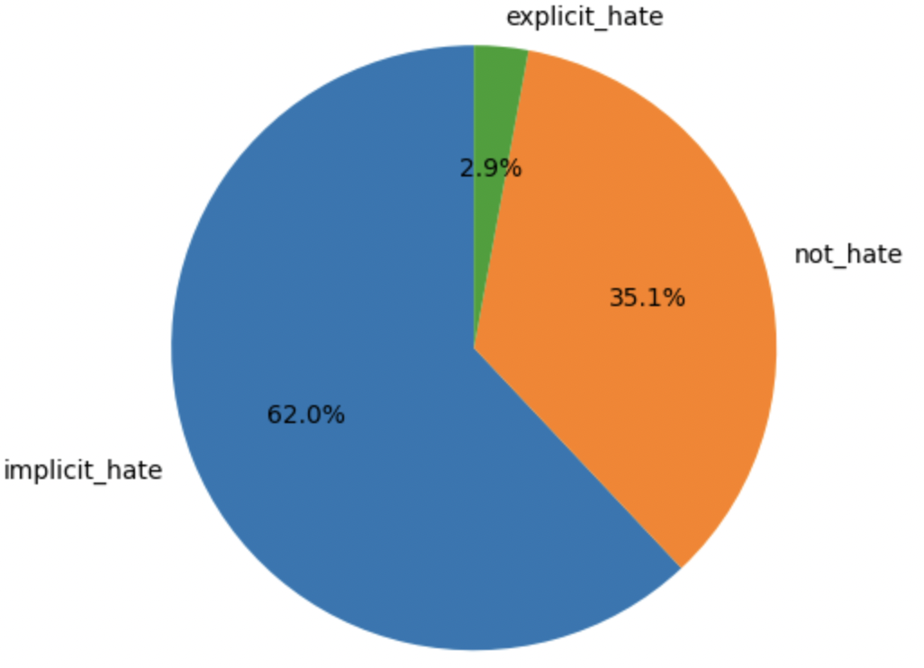
Dataset Analysis for Multi-Class Hate Speech Classification
implicit_hate 23495
not_hate 13294
explicit_hate 1093

Slide 6
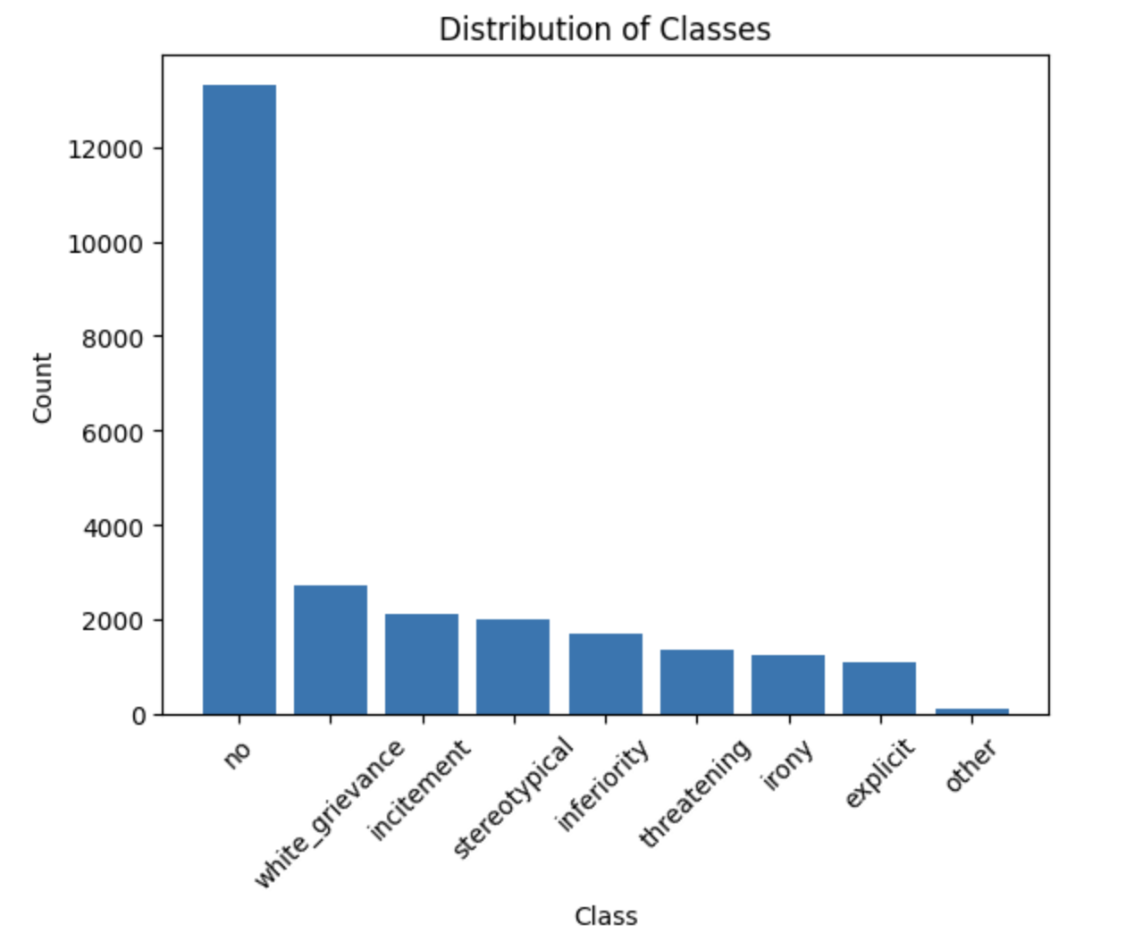
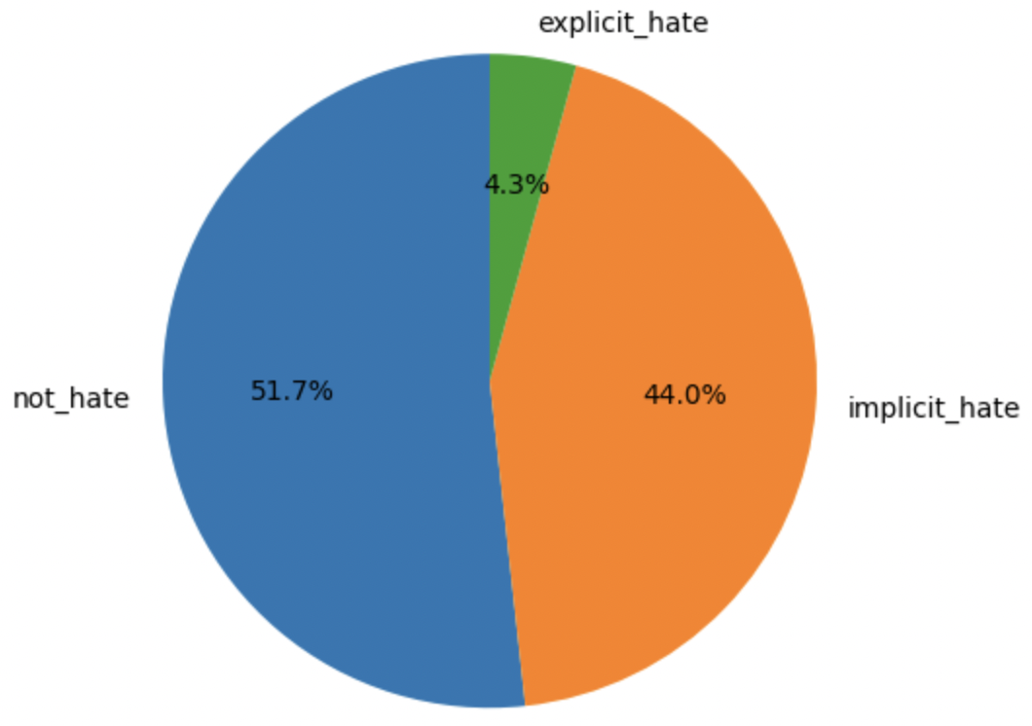
Dataset Analysis for Multi-Class Hate Speech Classification
threatening 1378
irony 1249
explicit 1093
other 110
no 13294
white_grievance 2736
incitement 2109
stereotypical 2006
inferiority 1720

Slide 7
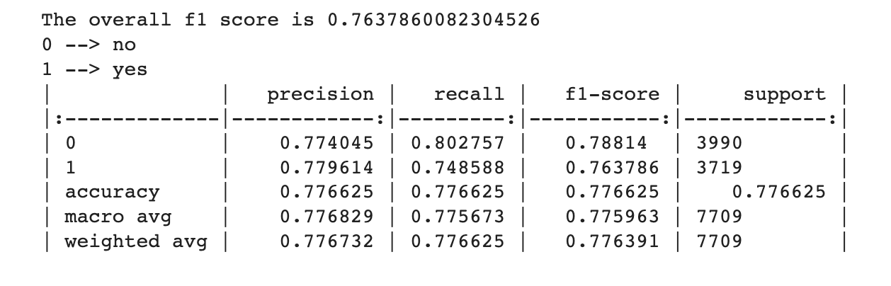
Non-Deep Learning Benchmark Model on Binary Classification
We used a Logistic Regression model as our non-deep learning benchmark model.
The accuracy obtained was 77.66%

Slide 8
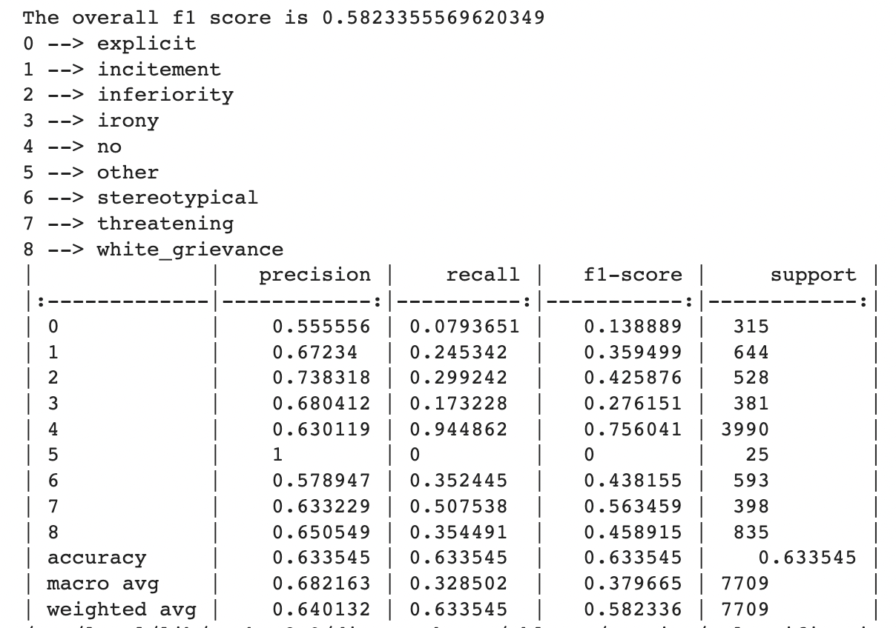
Non-Deep Learning Benchmark Model on MultiClass Classification
We used a Logistic Regression model as our non-deep learning benchmark model.
The accuracy obtained was 63.35%

Slide 9
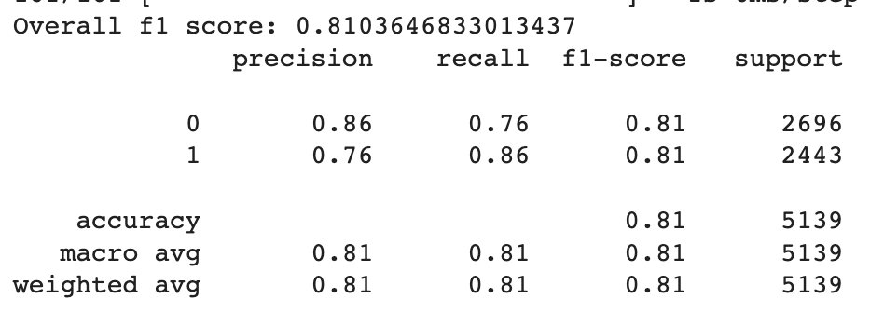
Deep Learning Benchmark Model on Binary Classification
We used a Feedforward Neural Network as our deep learning benchmark model.
The accuracy obtained was 80.77%

Slide 10
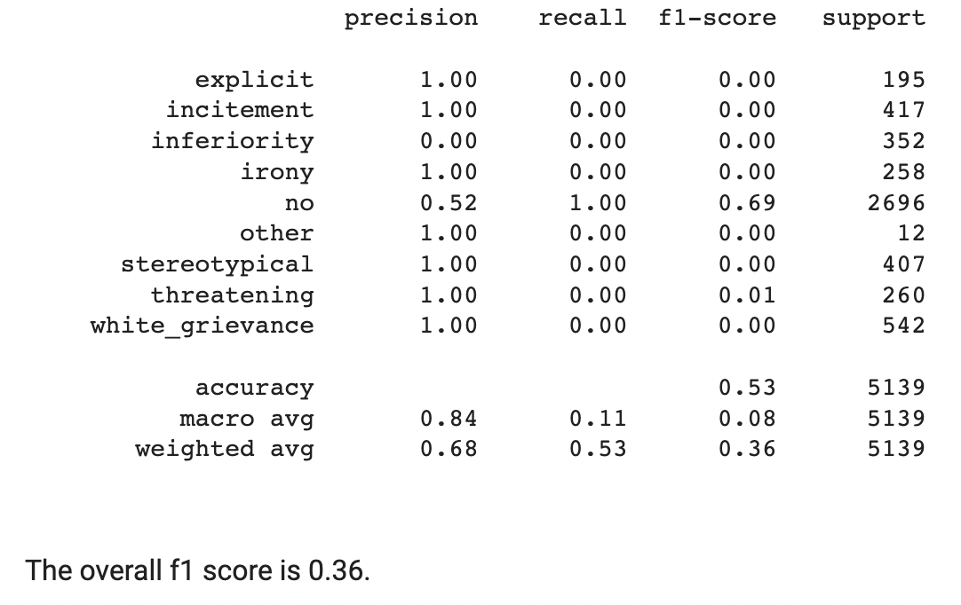
Deep Learning Benchmark Model on Multi-Class Classification
We used a Feedforward Neural Network as our deep learning benchmark model.
The accuracy obtained was 52.5%

Slide 11
Stanford’s ALPACA Model

Slide 12
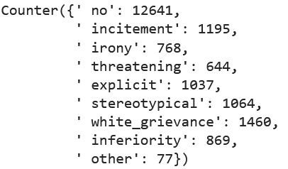
Training Data for Finetuning
With implicit classes defined
Without implicit classes defined

Slide 13
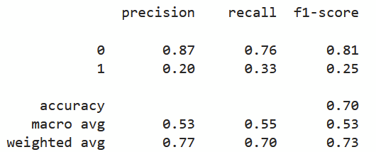
Fine-tuned Alpaca Results (No classes)
We fine-tuned an Alpaca model with a training dataset indicating whether or not a statement was an example of hate speech. We had an overall accuracy of 70%

Slide 14
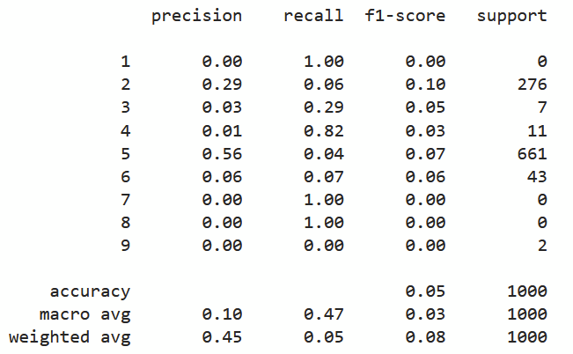
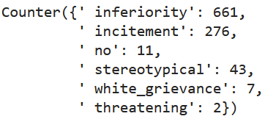
Fine-tuned Alpaca Results (Implicit classes)
Unexpectedly, we saw that the model did alarmingly poorly on detecting the specific implicit hate classes, along with separating between implicit, explicit, and non hate speech

Slide 15
GPT-3

Slide 16
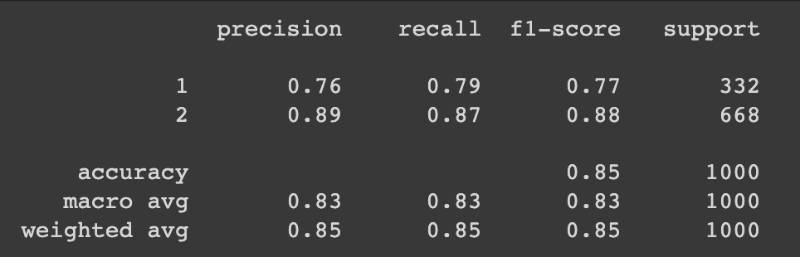
Fine-tuned GPT-3 Results (No Classes)
We then fine-tuned GPT-3 to distinguish between hate speech and non hate speech with 85% accuracy
yes: 1,
no: 2

Slide 17
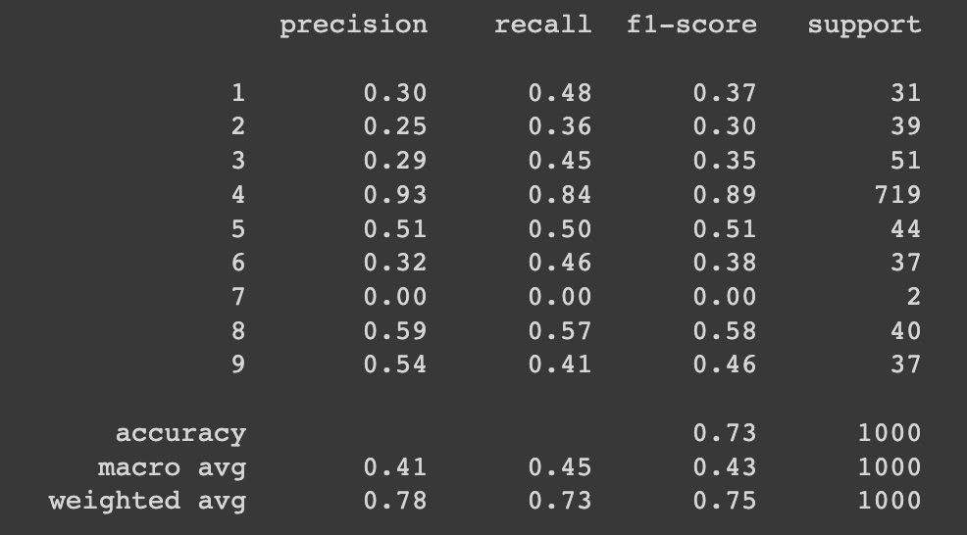
Fine-tuned GPT-3 Results (Implicit Classes)
We developed another model that further fine-tune the GPT3 with specific implicit hate speech classes. With the specific classes added to the label, we got a overall 73% accuracy
' explicit': 1,
' incitement': 2,
' white_grievance':3,
' no': 4,
' inferiority':5,
' stereotypical':6,
' other': 7,
' irony': 8,
' threatening': 9

Slide 18
Analysis

Slide 19
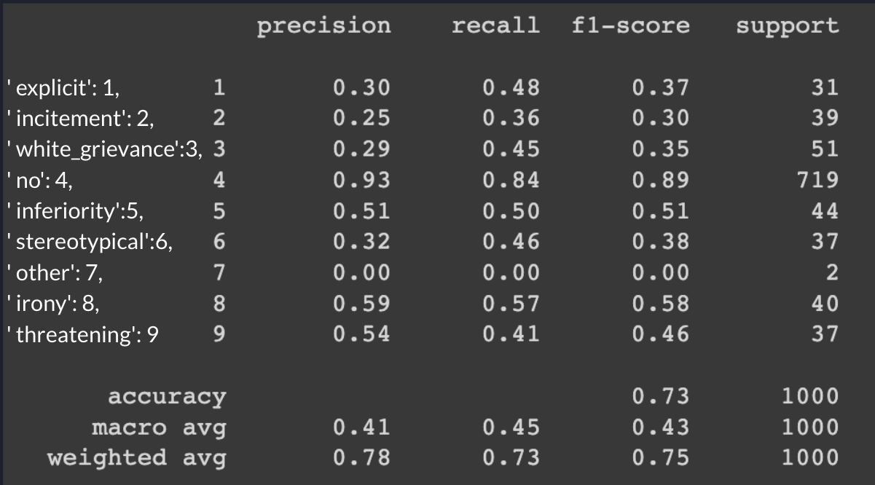
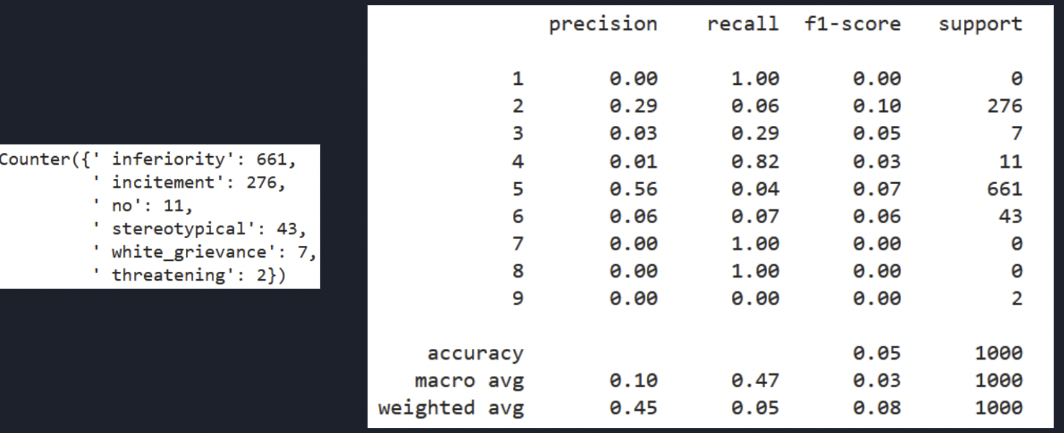
Comparing the two LLMs
GPT-3 Results
Alpaca Results

Slide 20
Key Considerations
Why did Alpaca perform so poorly?
Emphasis on thought prompting
Defaulting to a singular class of implicit hate speech
Further hyperparameter tuning (e.g. temperature)
Various technical issues
General trend of improvement
From Multiclass classification to Feedforward Neural Network to GPT-3, accuracy improved
LLMs (ideally) excel at understanding the nuances of hate speech

Slide 21
Questions?

